Slide 1







2
0
2
2
-- Hacking solutions to address the challenge of climate change and urban heat in the Triangle

Slide 2
Schedule for the Day
9:30 am - 5 pm - Hacking! Davie Hall room 101, 112 and 301
12:00 pm - Lunch Break
5:00 pm - Submit your video recording or slides for presentation. Instructions on Discord will be announced
5:00 - 6:00 pm - Pizza Break
6:00 - 8:00 pm Final presentations and Awards (come for raffle door prizes!) GSK Fulldome Theater at Morehead Planetarium

Slide 3
Formulating A Research Question
THINK ABOUT
What analytical skills do your team members possess?
What environments do your team members feel comfortable working in?
What sorts of questions surrounding heat do your team members find interesting?
THINK ABOUT
What do you want your project outcome to be?
How will you present this outcome?
Remember that you will probably encounter issues/challenges throughout the day. Some of these challenges can be time consuming. When formulating a research question, make sure you consider the time constraints and select a project that can be completed and somewhat polished within the available time

Slide 4
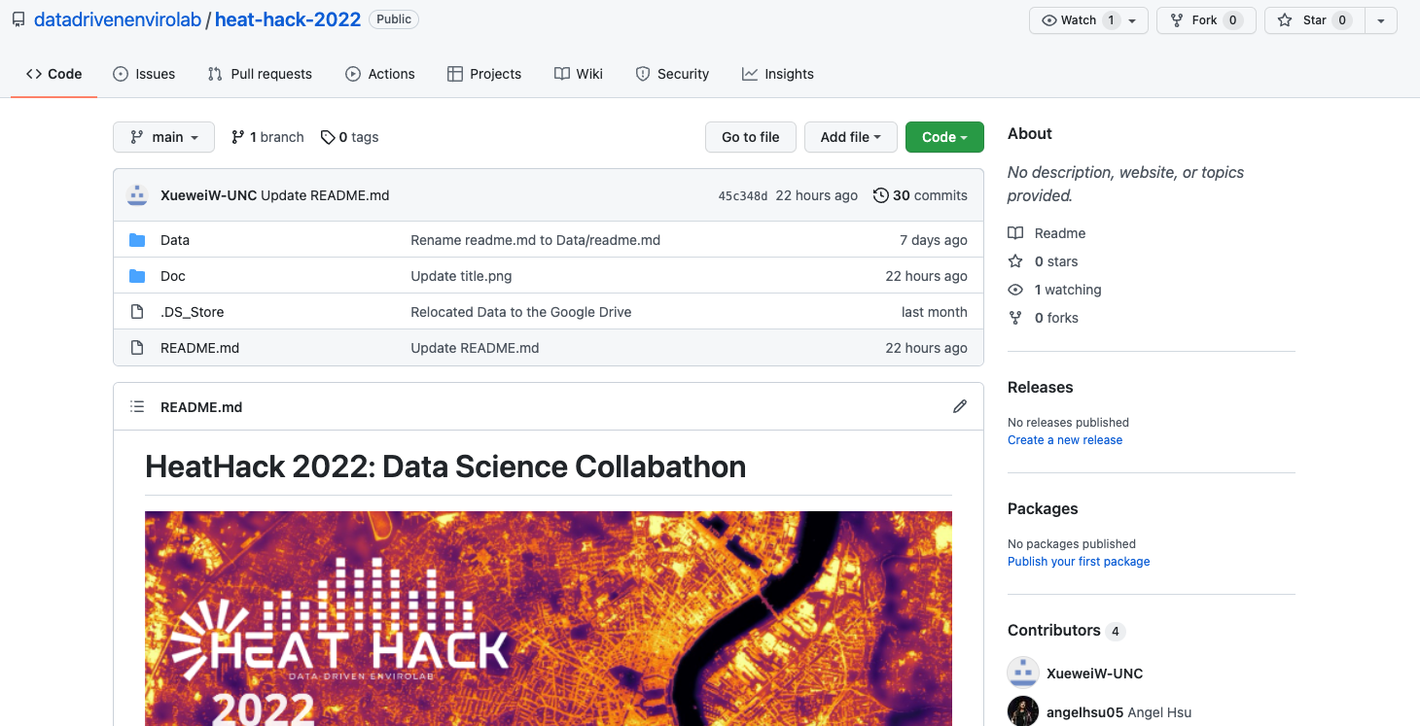
Accessing Data
Utilize the GitHub Page to access data, data documentation, and sample prompts (Your one-stop shop!)
Consider using the Desktop Version of GitHub
Large raw data is hosted on the Google Drive
If you are unfamiliar with GitHub, our data mentors are available to assist you

Slide 5
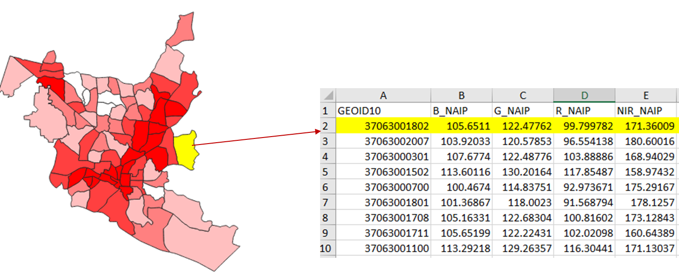
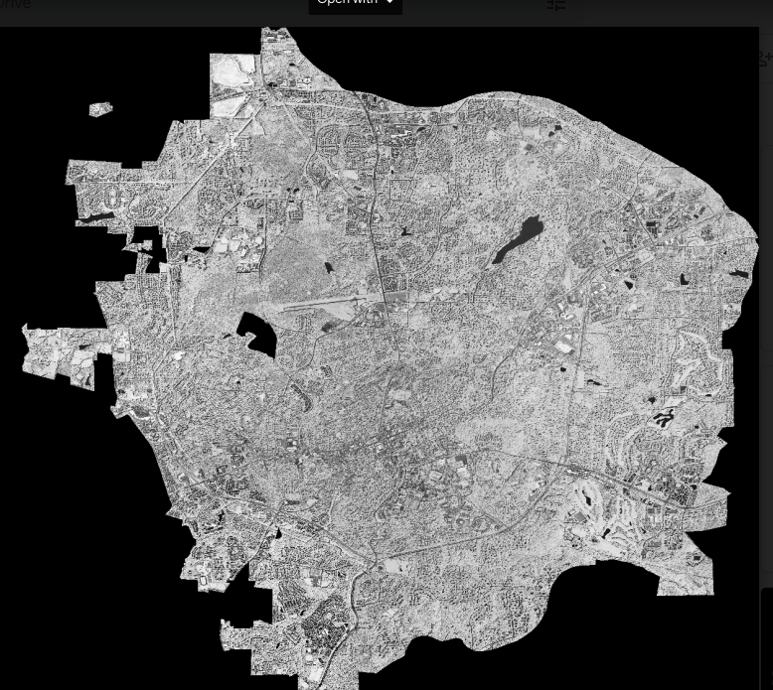
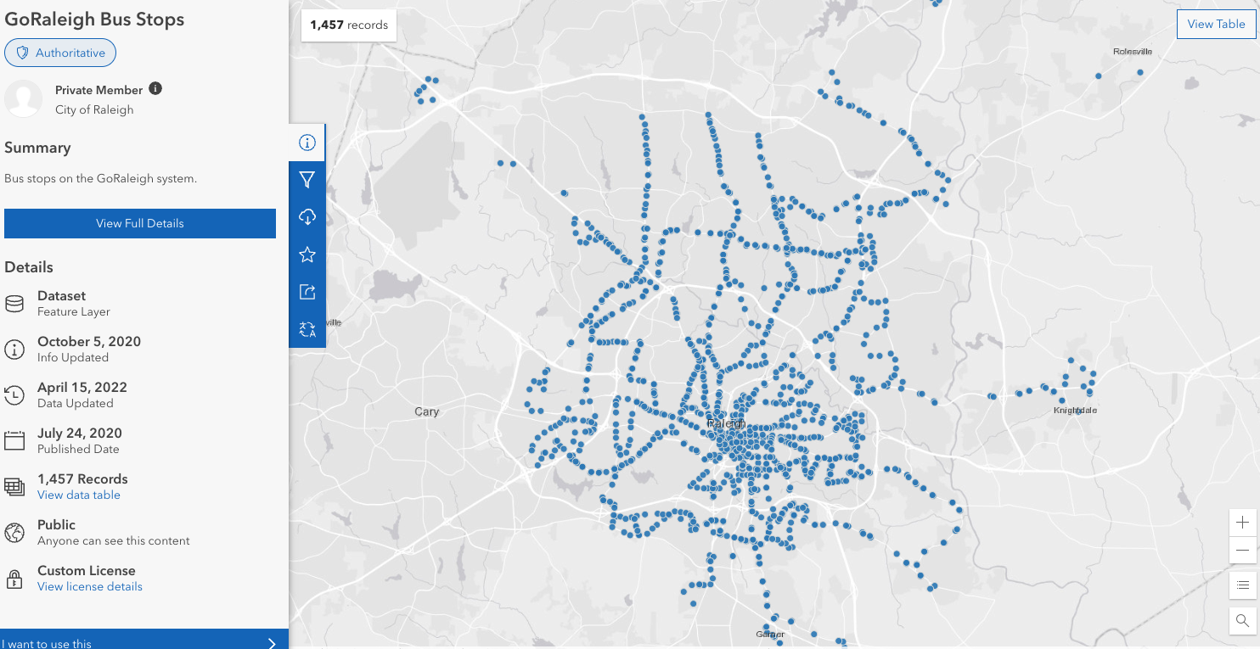
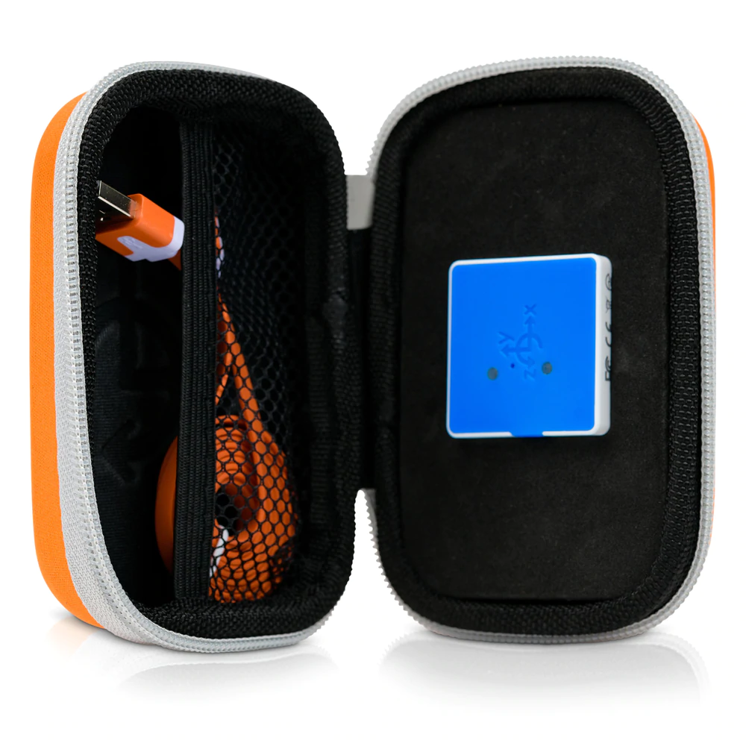
Available Data
Preprocessed and Aggregated Data
Great for people who are learning!
Raw Data
Good for people with more experience, especially experience working with spatial data
User Collected/ User Discovered Data
Participants can generate their own data, or find additional data on the web
Source: https://www.thepocketlab.com/store/pocketlab-weather?hsLang=en

Slide 6
“Introductory Questions”
Which people and areas are affected the most by heat?
How to define group of people? By age, income level, race, or other characteristics?
What data we may need to figure out the location information?
What are the proxies to measure heat stress?
Absolute temperature v.s Temperature difference between day/night
Rate of Heat related symptom or disease?
What can cities do to better protect citizens against extreme heat exposure and lessen disparities?
How data can help us addressing this and aware people of potential risk?
Heat stress alert system? A mobile App?
Planting more trees or create more shade area?
Where we should plant the trees and what are the suitable species?
Notes:
help you start thinking about issues related to urban heat. These questions cannot necessarily be answered using data analysis, but are intended to help you start brainstorming topics and issues for your project.

Slide 7
“Starter Pack”
How does temperature vary with environmental features (such as green space, paved surfaces, tree cover)?
Sample Analysis Steps:
Utilize pre-processed census block group or tract data, or point data and use columns such as “Impervious_Surface” or “Tree_Coverage” to explore relationships with temperature variables “af_t” or “pm_t”
Analyze in an environment you’re comfortable in. You can keep the data in Excel if you want!
What are some common characteristics of areas with higher heat?
Sample Analysis Steps:
Utilize pre-processed census block group or tract data, or point data and use columns such as “Median Household Income (in 2019 Inflation Adjusted Dollars)” to explore relationships with temperature variables “af_t” or “pm_t”
Notes:
can be investigated using the pre-processed heat data and input variables

Slide 8
Advanced Challenges
If a town or city in the Triangle area wanted to implement heat mitigation strategies to lower the temperature in urban areas, what areas should they focus on first? Which heat mitigation strategies would be best for which locations?
Potential to integrate spatial analysis strategies and merge temperature and demographic data with a spatial component. Potential to research available heat mitigation strategies
How do patterns of temperature correspond to or conflict with city planning goals?
Potential to to integrate datasets such as Durham Future Land Use, Raleigh Development Plans, Durham Open Space Plan
Notes:
more advanced topics related to vulnerable populations and policy applications that might require you to find and incorporate other datasets.

